Slide 1
Software Architecture
Monte Carlo step to new TBF parameters
1
2
Load molecules
Create list of distortions
Create TB models
Generate accuracy vectors (AV)
Model and Training data
Initialize universal model (UM)
3
Train p(s’,s) to generate ideal models
Train a GFlowNet reward function
Related NN approaches are used for model optimization in high energy physics due to similar ‘curse of dimensionality’ challenges.

Slide 2
Context and Motivation
Tight binding models (no density functional)
Run time ratio
10⁸
10⁷
10⁶
10³
10⁰
Correlated diagonalization (CASPT2, NEVPT2, …)
Variational Monte Carlo
DFT
Molecular Mechanics
Semi-Empirical
DFT
Quantum-aware AI
>~0.01Å accuracy with well-selected functionals
Using Neural Network Force Fields to Ascertain the Quality of Ab Initio Simulations of Liquid Water, A Torres, LS Pedroza, M Fernandez-Serra, AR Rocha - The Journal of Physical Chemistry B 125 (38), 10772-10778
Density functional tight binding: values of semi-empirical methods in an ab initio era, Q. Cui and M. Elstner, Phys. Chem. Chem. Phys., 2014, 16, 14368–14377

Slide 3
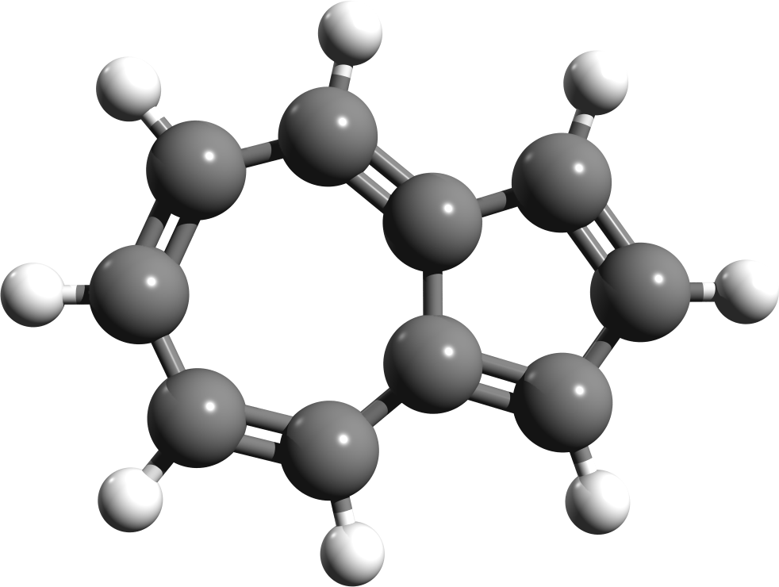
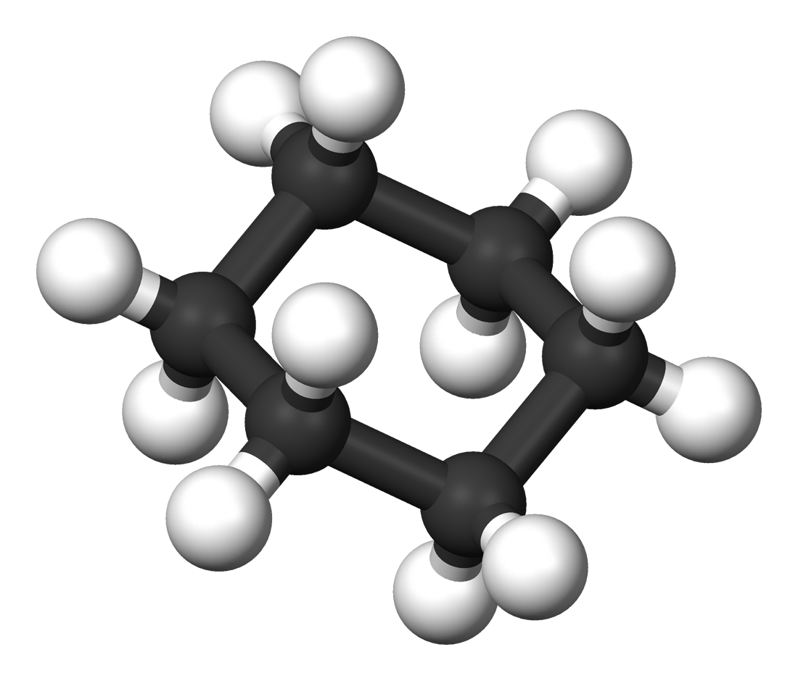
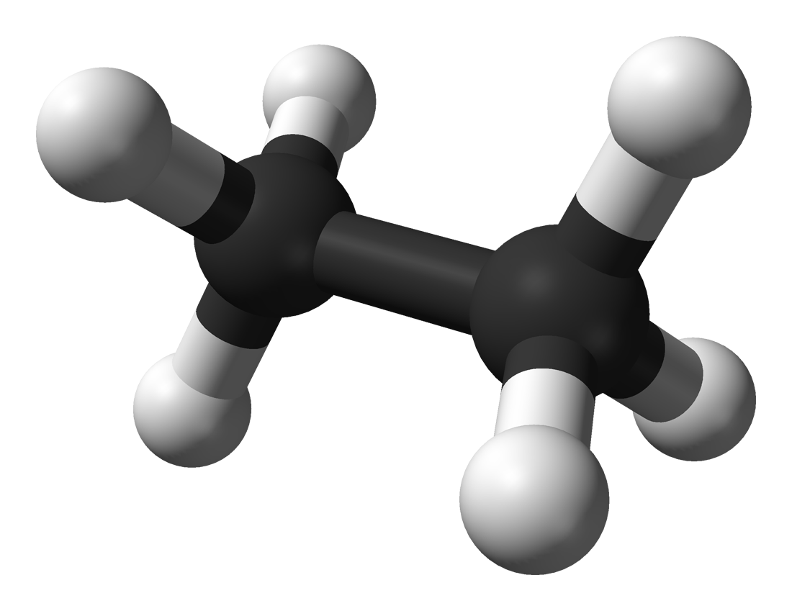
Tight binding field
A universal model mapping from bond lengths to tight binding parameters
Demo case: s, p basis; C, H atoms; curves defined by 5 parameters → 87 dimensions
Fields respect Slater-Koster symmetry and are:
Coulomb: atom-atom
Coulomb: atom-orbital
Coulomb: orbital-orbital
Coulomb: atom-2 orbital (allowing hybridized sp orbitals)
Hopping (all Slater-Koster–allowed orbital combinations)
Non-field parameters:
Orbital energy

Slide 4
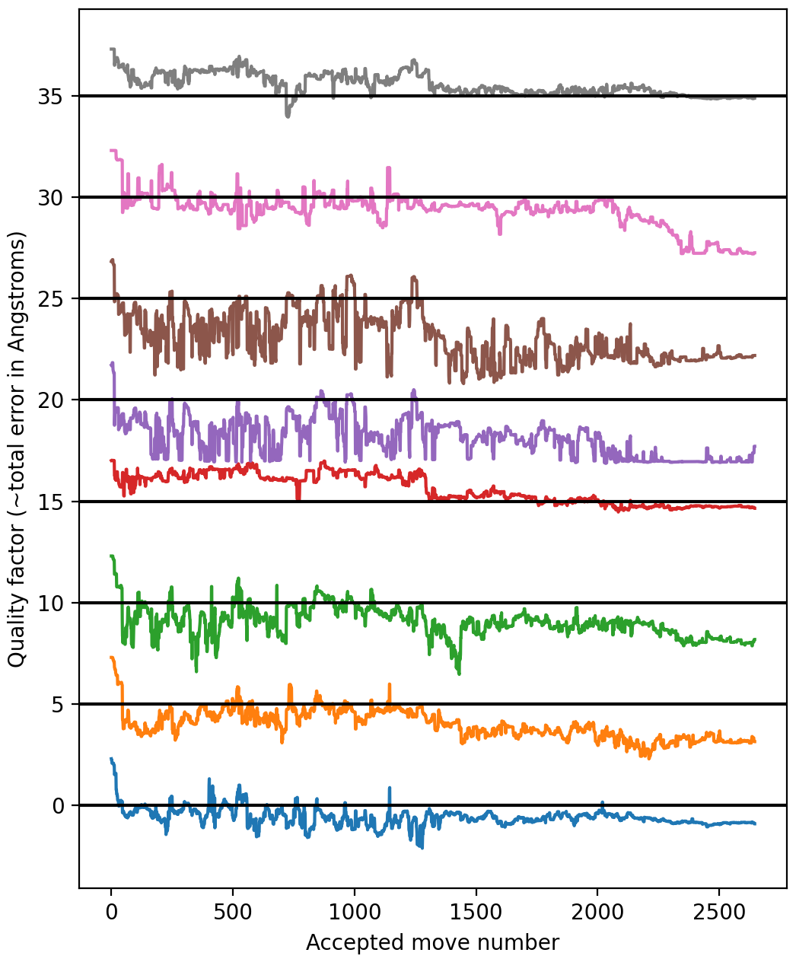

3-step Monte Carlo convergence for 8 molecules
Quality factor (log scale)
Each step involves diagonalizing for 40 configurations
Lines represent ~0.1 Å/bond
Accepted move number
Molecular structures selected from the Cambridge Structural Database (CSD) hosted by the Cambridge Crystallographic Data Centre (CCDC)

Slide 5
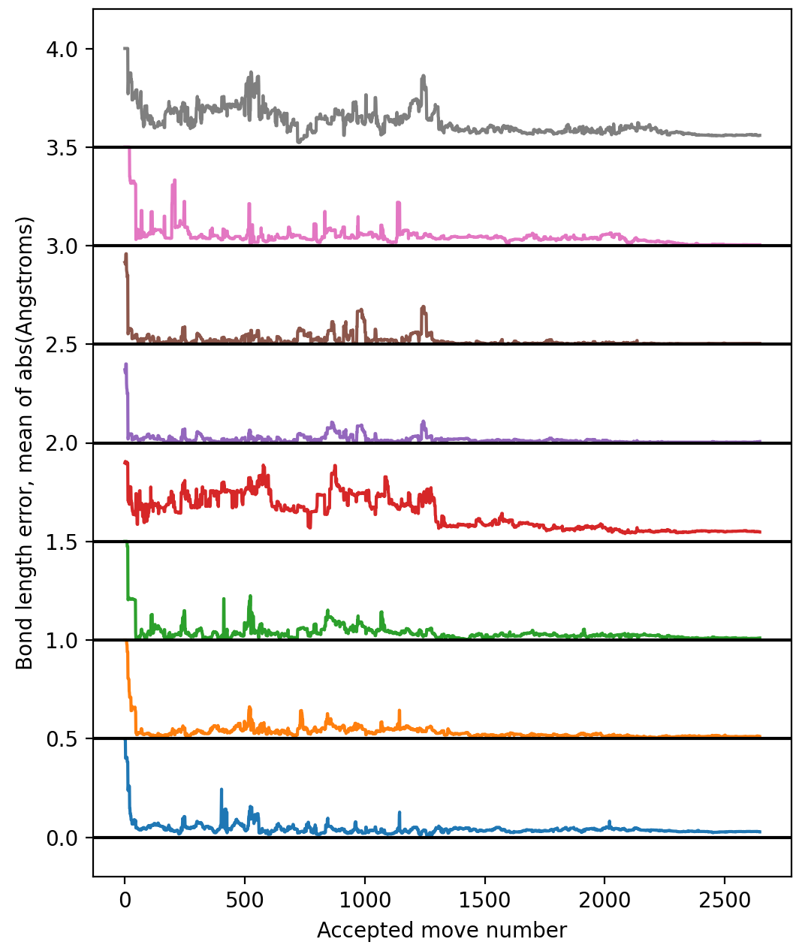
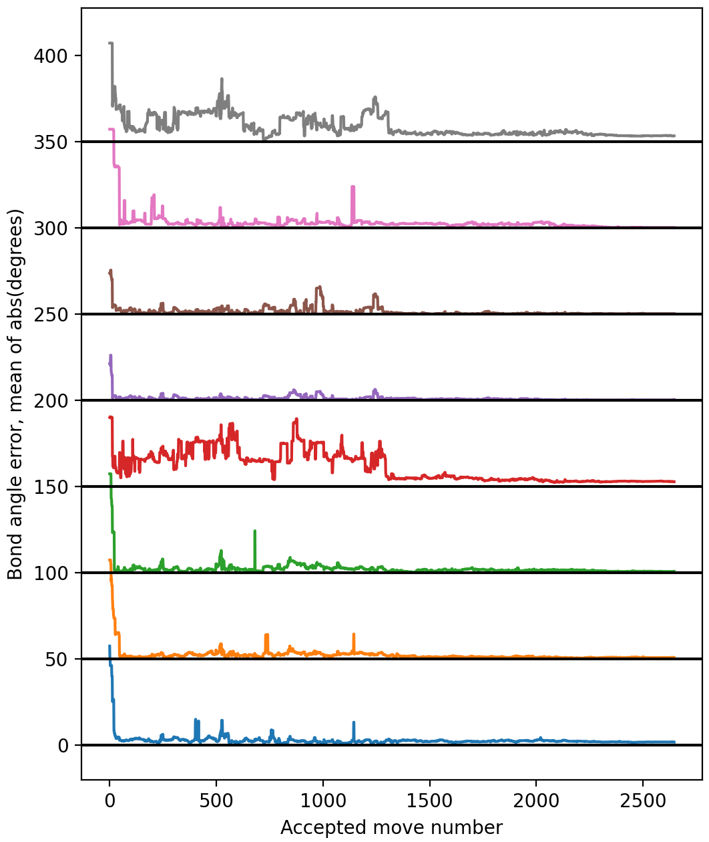

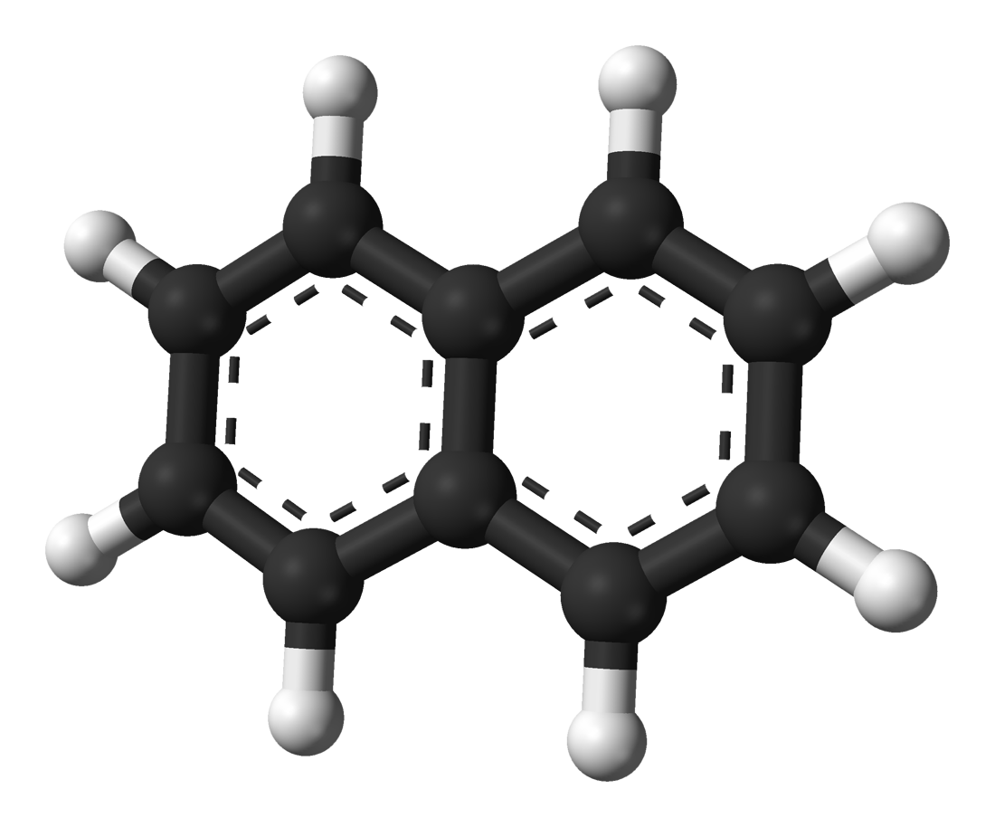
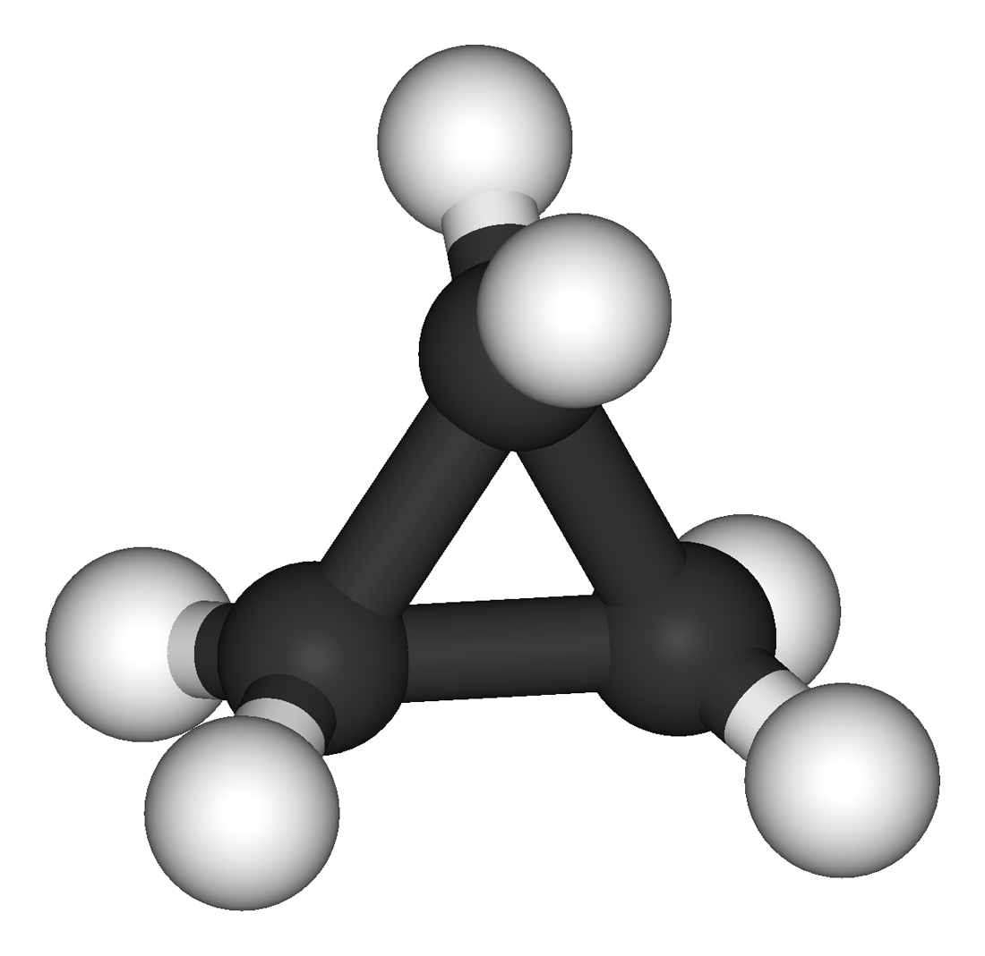
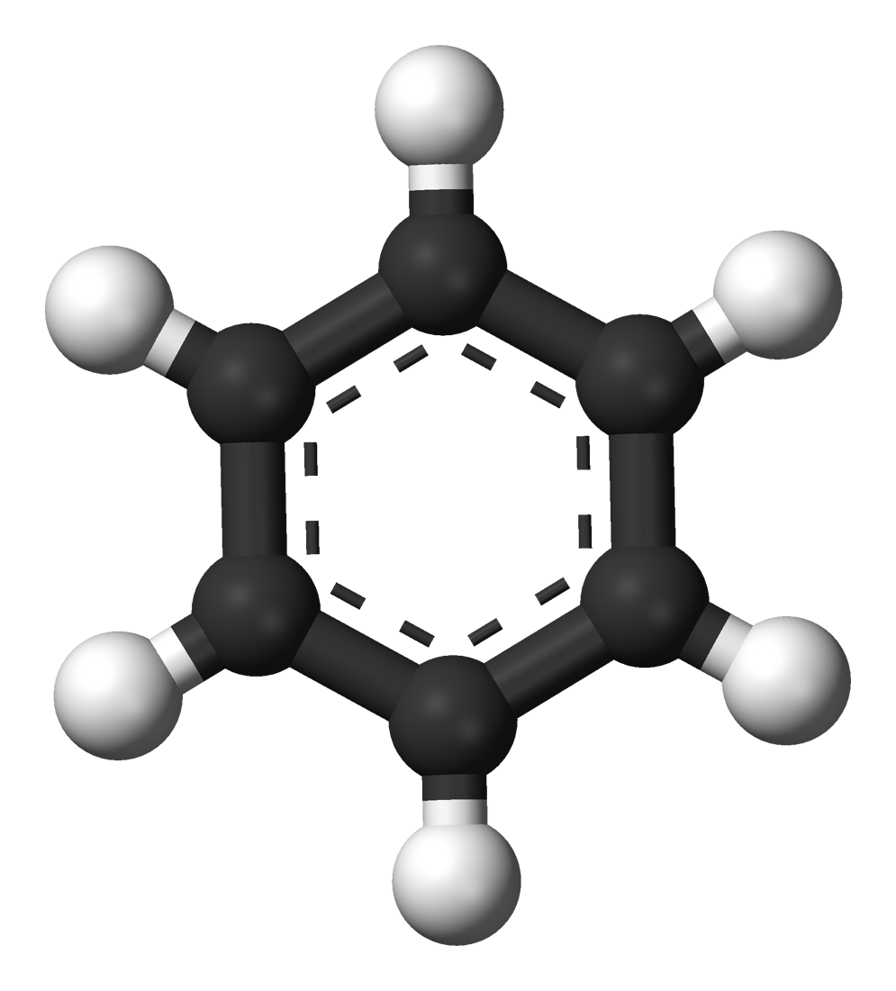
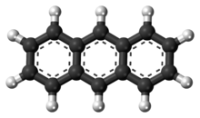
n-heptane
naphthaline
ethane
cyclopropane
cyclohexane
benzene
azulene
anthracene

Slide 6
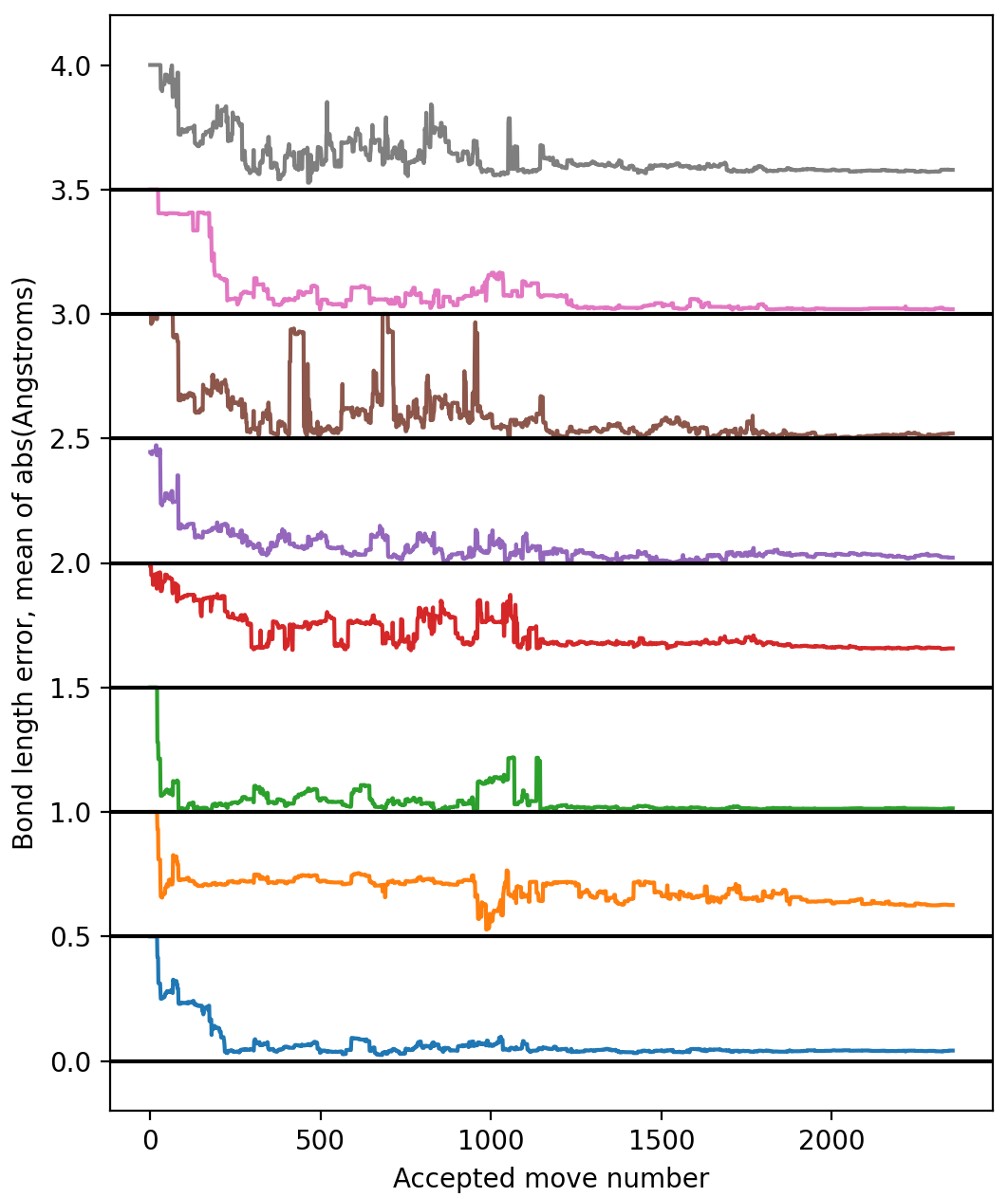
Full Model
No Hopping (2-body bond type-resolved interactions)
n-heptane
naphthaline
ethane
cyclopropane
cyclohexane
benzene
azulene
anthracene

Slide 7
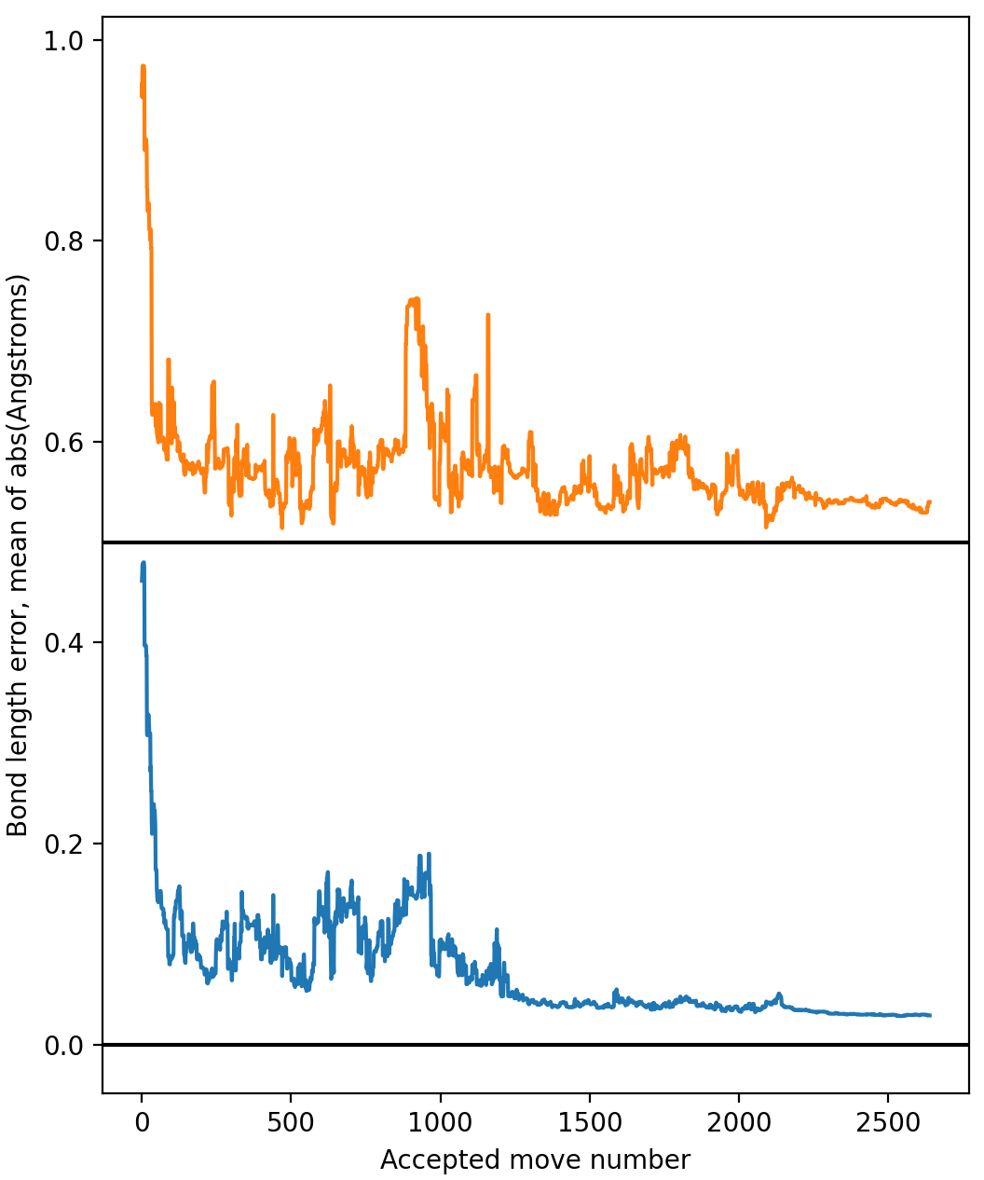
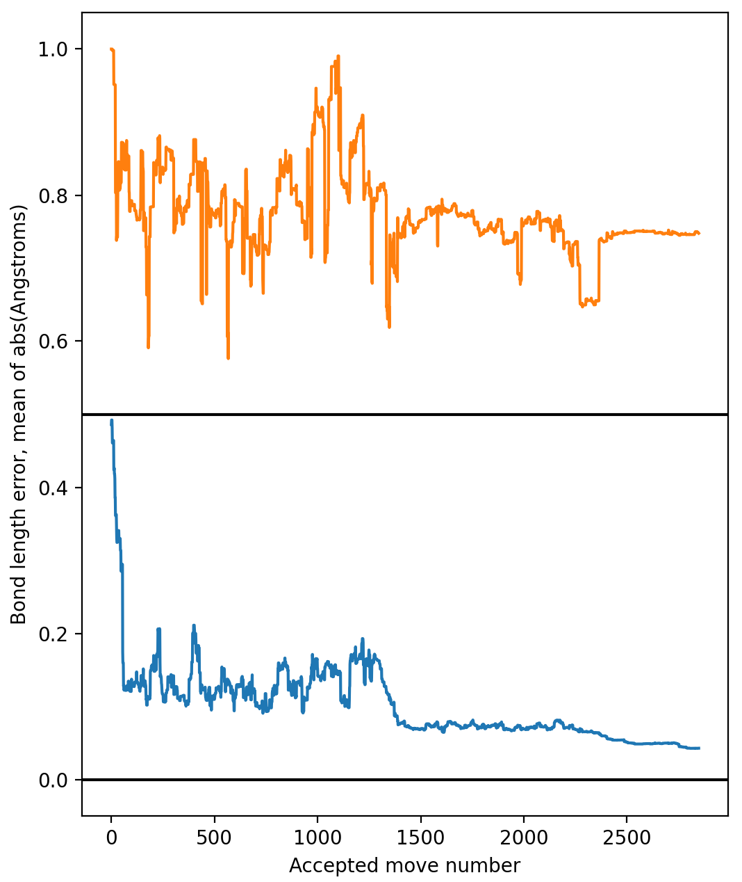
Evaluating test data
Full Model
No Hopping
naphthaline
ethane

Slide 8
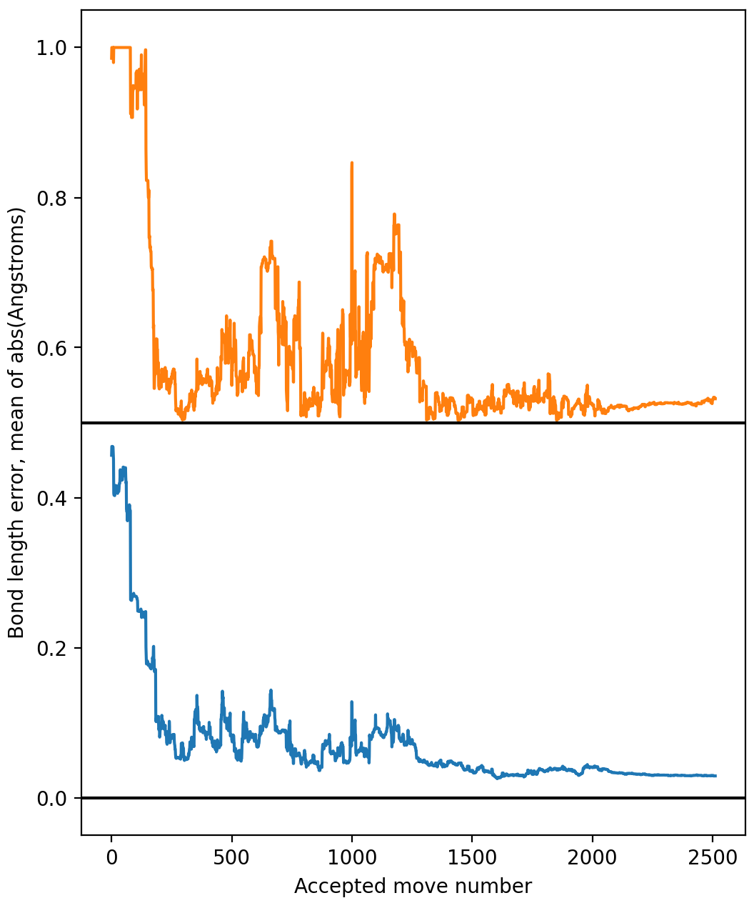
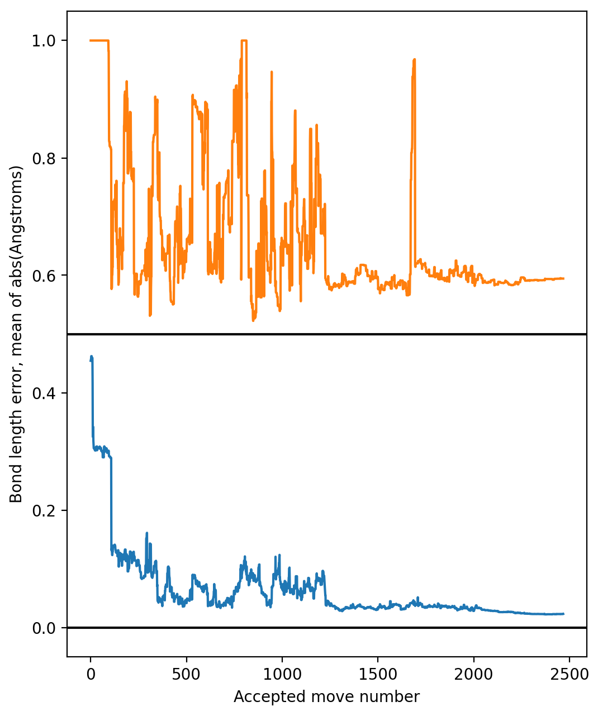
Overfitting the training data
n-heptane
cyclopropane
0.02→0.03Å
0.08→0.095Å!

Slide 9
Advantages
Can handle delocalized wavefunctions (rings, chains).
Speed of ~5 ms/config for a 20 atom molecule. (time~n³)
Error can be comparable to DFT (~1% of bond length) following Monte Carlo optimization, and possibly superior.
If successful scenarios are identified, it can plug into existing use cases for better-than-MM optimization.

Slide 10
Development frontiers/Limits
The quantum model is partly missing charge density dependence. Density terms can be added at a cost of ~1.2-10 times the computational time.
Fields should depend on whether there is another atom in the way (3-body terms). This is currently mitigated by making the hopping field short range. Limited 3-body terms can be added with negligible computational overhead.
Converged TBF parameter sets from different runs can look quite different, but give similar performance. A random forest approach may increase accuracy at the cost of time.
As for AI-based approaches, model dimensionality includes terms that grow as the factorial of the number of elements. Adding O and N multiplies dimensionality by 4.6. Going beyond ~6 elements will likely require sequential training for cycles with different groups of elements, even after the AI optimization loop is implemented.
Cluster physics is missing. Accuracy may hit a DFT-like limit.

Slide 11
Immediate next steps
Full implementation of the neural network loop.
Close characterization of model performance, including more manipulations (twists, full structure relaxation.
Characterization for nitrogen- and oxygen-bearing molecules.

